Slide 1
Cascode
By: Johan Saltin
Class: EE 222
Professor: Dr. Hiu Yung Wong
School: San Jose State University, College of Engineering

Slide 2
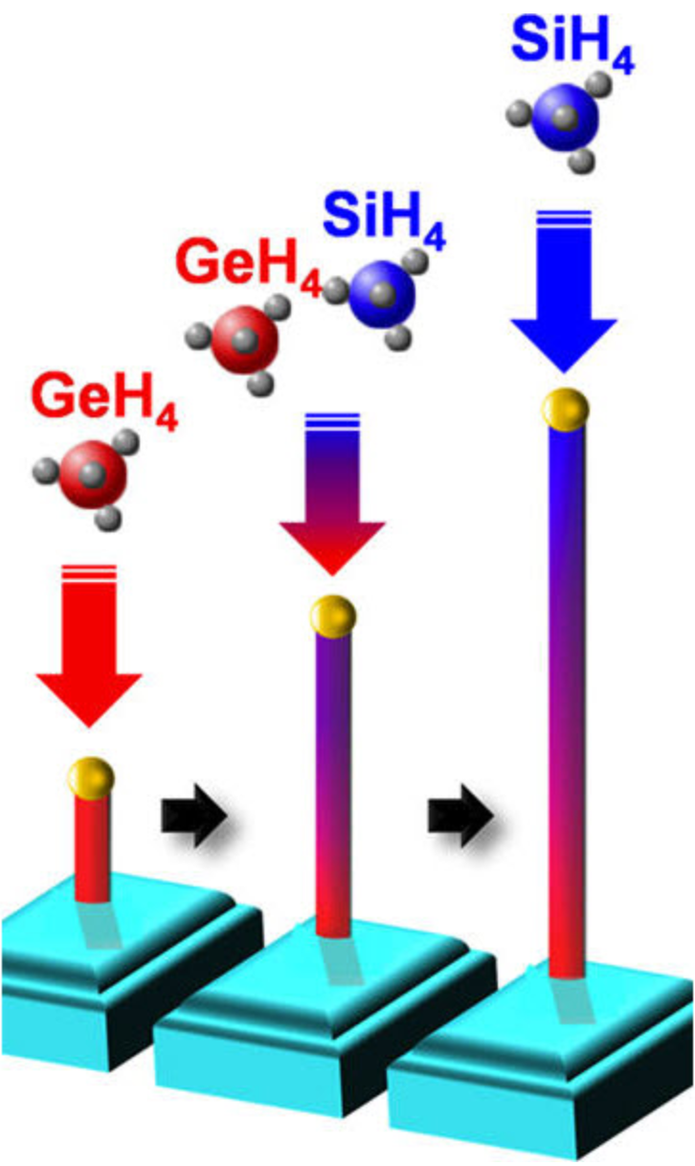
Purpose
I_{on}/I_{off} Ratio
Nano structure properties not met as Homojunction or junction less devices
Possibility in both nMOS and pMOS
[1]

Slide 3
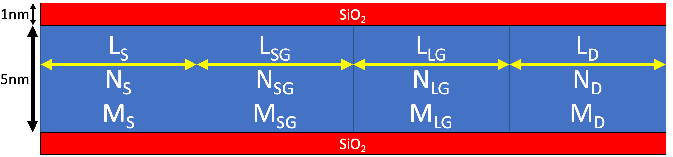
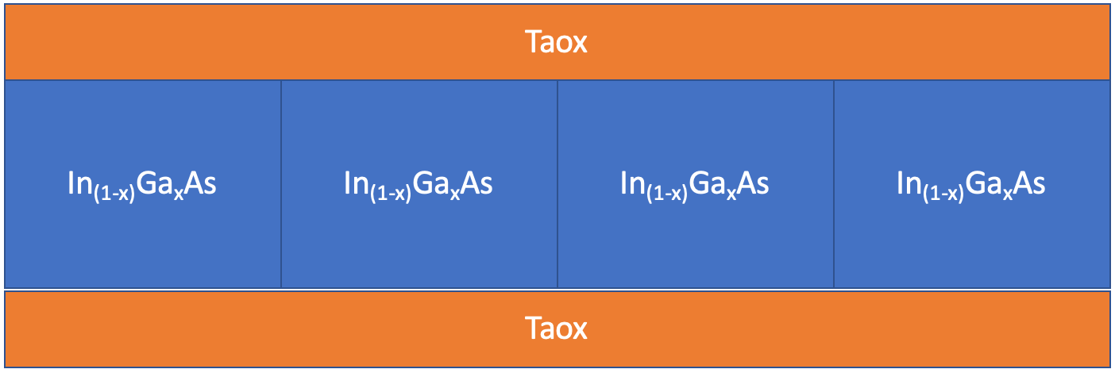
Important
I_{on}
I_{off}
Potential drop
Fig 1. Device layout for pMOS
Fig 2. Device layout for nMOS

Slide 4
Fig 3. IdVg graph of pMOS against change of length in LG

Slide 5
Fig 4. IdVg graph of pMOS against a Silicon. Germanium, and structure with Silicon in SG and LG but Ge in SD

Slide 6
Potential drop
To obtain a valid Cascode effect within the device, the potential difference should be much larger across the Long Gate (LG) structure of Gallium than the Short Gate (SG) of silicon.

Slide 7
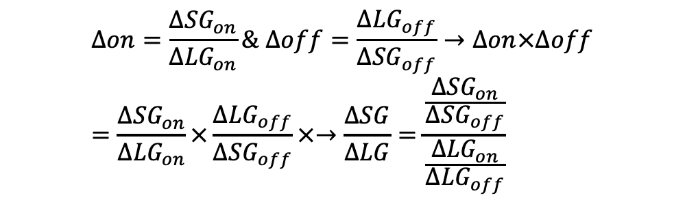
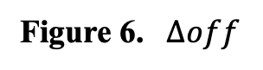
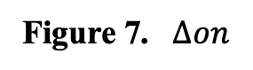

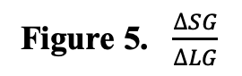
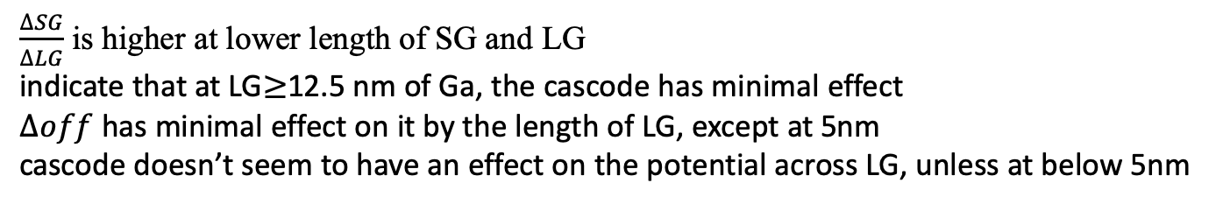
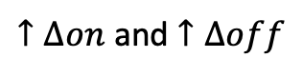
$$∆on=\frac{{∆SG}_{on}}{{∆LG}_{on}}\& ∆off=\frac{{∆LG}_{off}}{{∆SG}_{off}}→∆on×∆off=\frac{{∆SG}_{on}}{{∆LG}_{on}}×\frac{{∆LG}_{off}}{{∆SG}_{off}}×→\frac{∆SG}{∆LG}=\frac{\frac{{∆SG}_{on}}{{∆SG}_{off}}}{\frac{{∆LG}_{on}}{{∆LG}_{off}}}$$
Most Desirable
$↑∆on$ and $↑∆off$
on: V_{G}=-0.65 and V_{D}=-0.65 vs V_{G}=0 V_{D}=-0.65
off: V_{G}=-0.65 V_{D}=0 vs Vg=0 V_{D}=0.
Figure 5. $\frac{∆SG}{∆LG}$
Figure 6. $∆off$
Figure 7. $∆on$
$\frac{∆SG}{∆LG}$ is higher at lower length of SG and LG
indicate that at LG$≥$12.5 nm of Ga, the cascode has minimal effect
$∆off$ has minimal effect on it by the length of LG, except at 5nm
cascode doesn’t seem to have an effect on the potential across LG, unless at below 5nm
For Future experiments one could increase the number of carriers within SG, to determine the change in $\frac{∆SG}{∆LG}$

Slide 8
In_{0.53}Ga_{0.47}As

Slide 9
Lg=3,5,8,10, and SD=5,25,50. All at 1E19

Slide 10
Conclusion
Constructed
pMOS Cascode
nMOS Cascode
pMOS shows device improvements, but not to expectations
nMOS shows great potential, but in need of 3.5x the SD than channel
Future
Develop more data regarding nMOS structures for cascode purposes
Introduce AlGaAs for Ultra wide bandgap, increasing potential drop across

Slide 11
References
DOI: 10.1021/cr400261y

